Slide 1

SMART WATER MANAGEMENT TECHNOLOGY
PCL PRESENTATION
Shahad K, Ravi Giri, Yaovi Joel, Herve Claudel Ineza, Amara A. Kamara

Slide 2
CONTENT
1. Literature Survey
6. Software Required
2. Problem Statement
7. Progress
3. Existing Systems
8. Expected Outcomes
4. Proposed System
9. References
5. Hardware Required

Slide 3
LITERATURE SURVEY
1

Slide 4
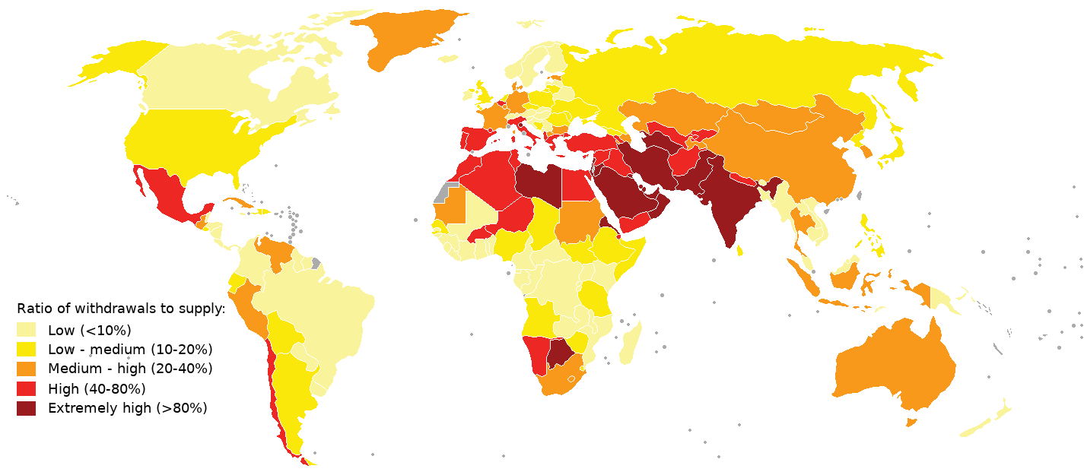
PROBLEM STATEMENT
UNESCO highlights water quality as a key 21st-century challenge, posing threats to human health, limiting food production, reducing ecosystem functions, and hindering economic growth.
Fig: Global Water Stress 2019
2

Slide 5


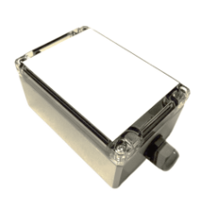
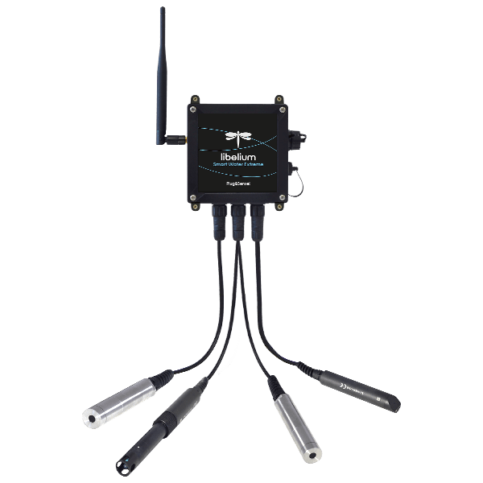
EXISTING SYSTEMS
Micronova's solution is an innovative smart industrial water management tool (leakage detection).
Libelium's Smart Water Xtreme is a device with enhanced sensor accuracy for superior water quality monitoring.
3
3

Slide 6




SOFTWARE REQUIREMENTS
MOBILE APP
CLOUD SERVICE
AI MODEL
Embedded Programming
React Native
ThingSpeak
Python
Arduino
5
4

Slide 7
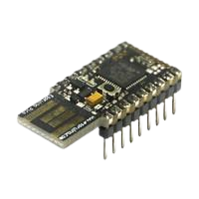
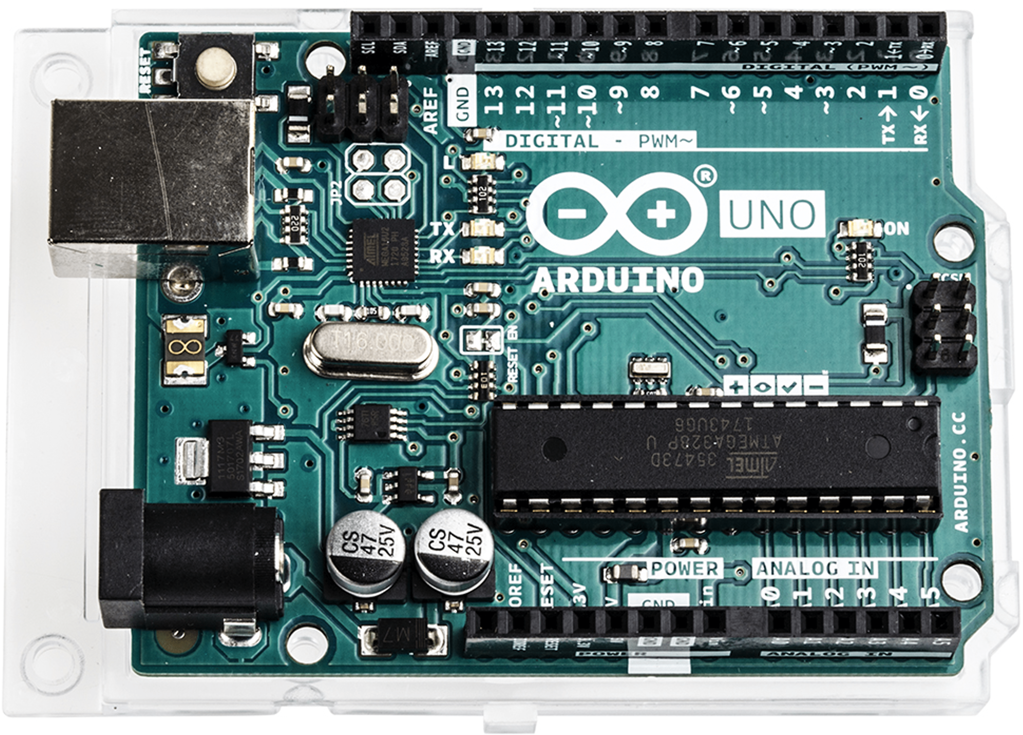
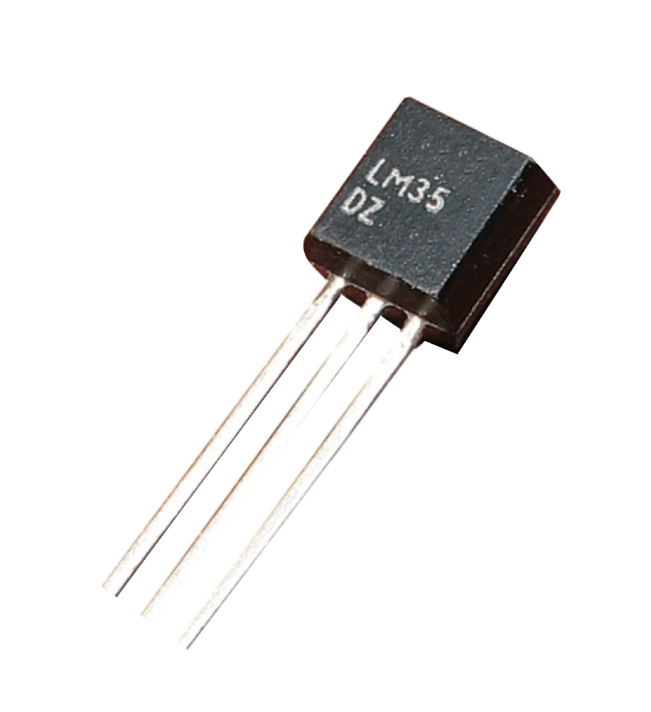
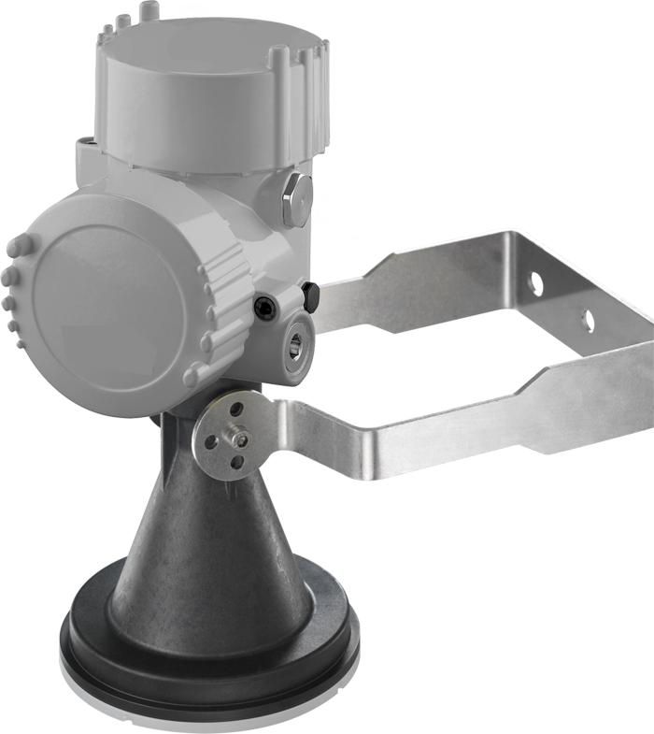
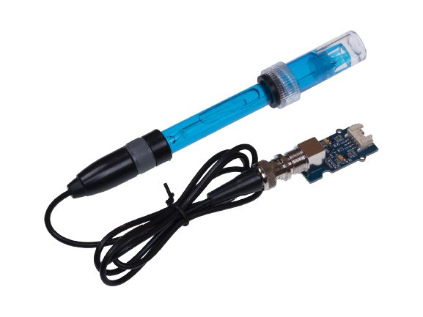

HARDWARE REQUIREMENTS
MICROCONTROLLER
SENSORS
PROTOCOL
WIFI MODULE
Leakage
Ultrasonic
pH
Turbidity
Temperature
Arduino Mega
MQTT
ESP-01
6
5

Slide 8
ARCHITECTURE
5 LAYER ARCHITECTURE
PERCEPTION
NETWORK
MIDDLEWARE
APPLICATION
BUSINESS
7
6

Slide 9
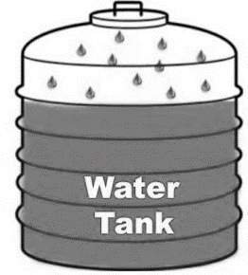
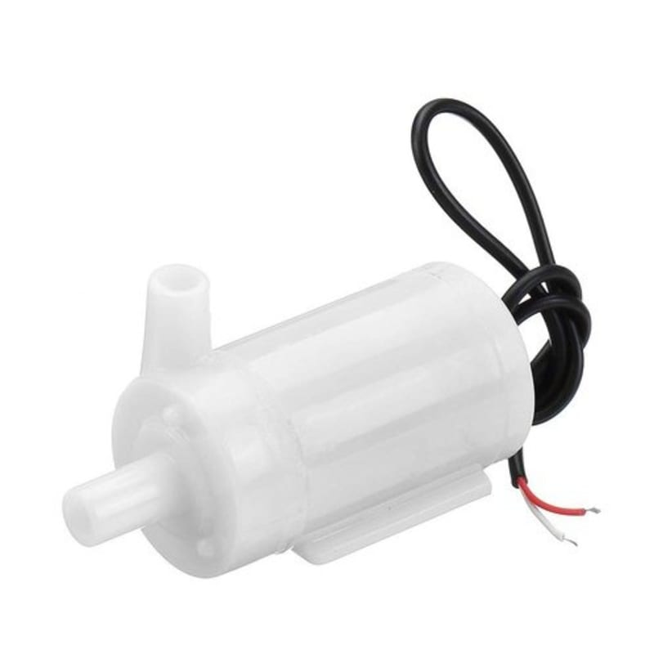
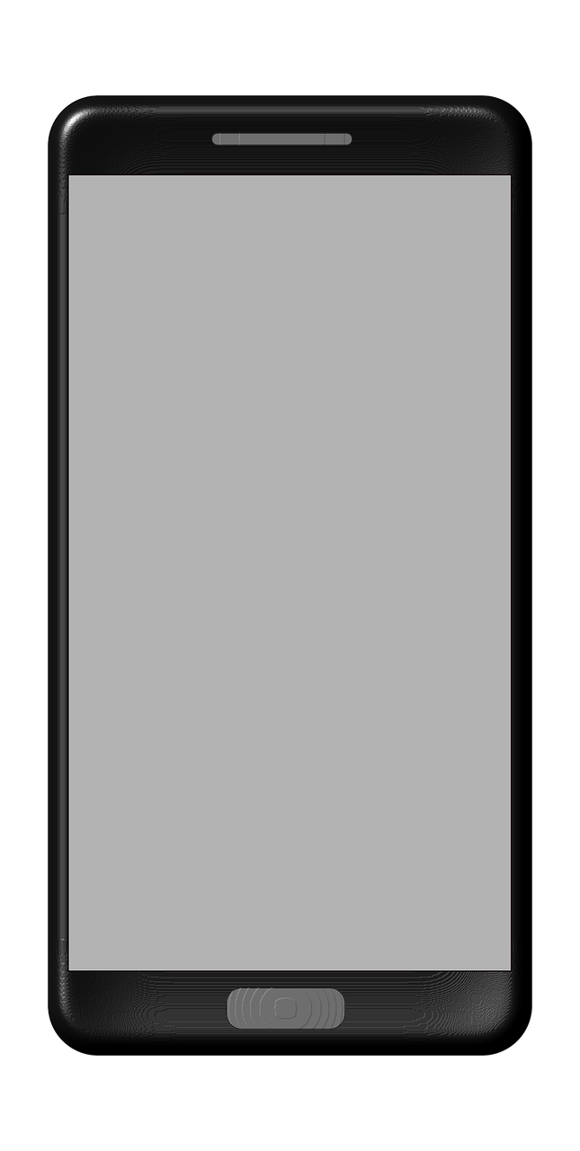
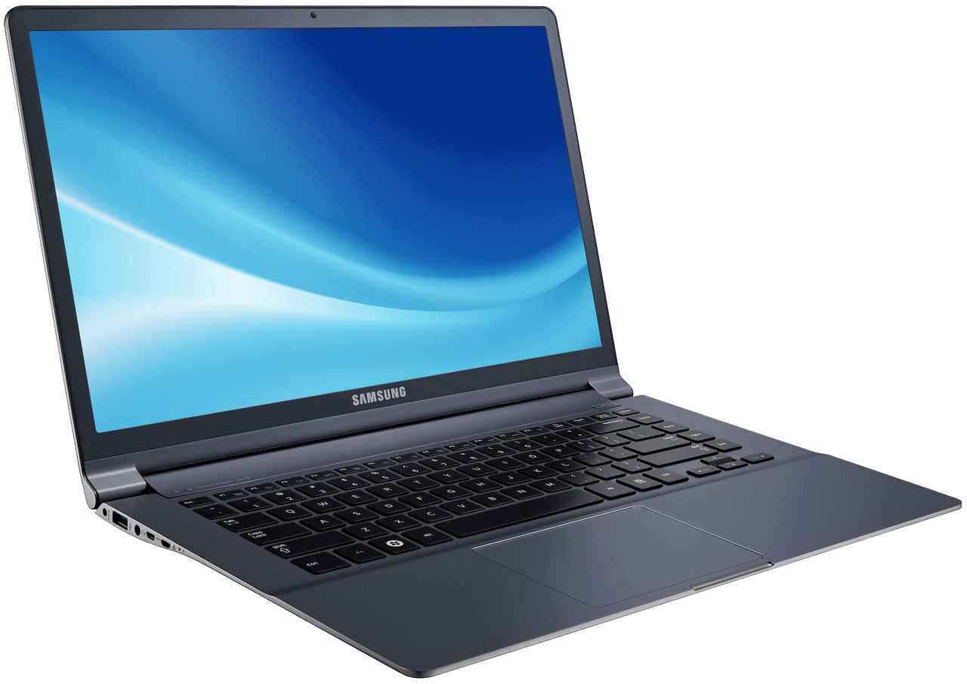


HIGH-LEVEL ARCHITECTURE
MIDDLEWARE Layer
Triggers
Sensor Data
PERCEPTION
Network Layer
Actuate pump
Triggers
Data
Actuator
Signal
Triggers
Sensor Data
Application layer
Sensing tank
Actuator Element
Water Pumps
Sensing Element
Wifi/LoRaWan Connection
Sensor Data
ESP-01
LoRA
BUSINESS layer
Leakage Ultrasonic pH Turbidity Temperature
7
7
End Users / Stakeholders

Slide 10

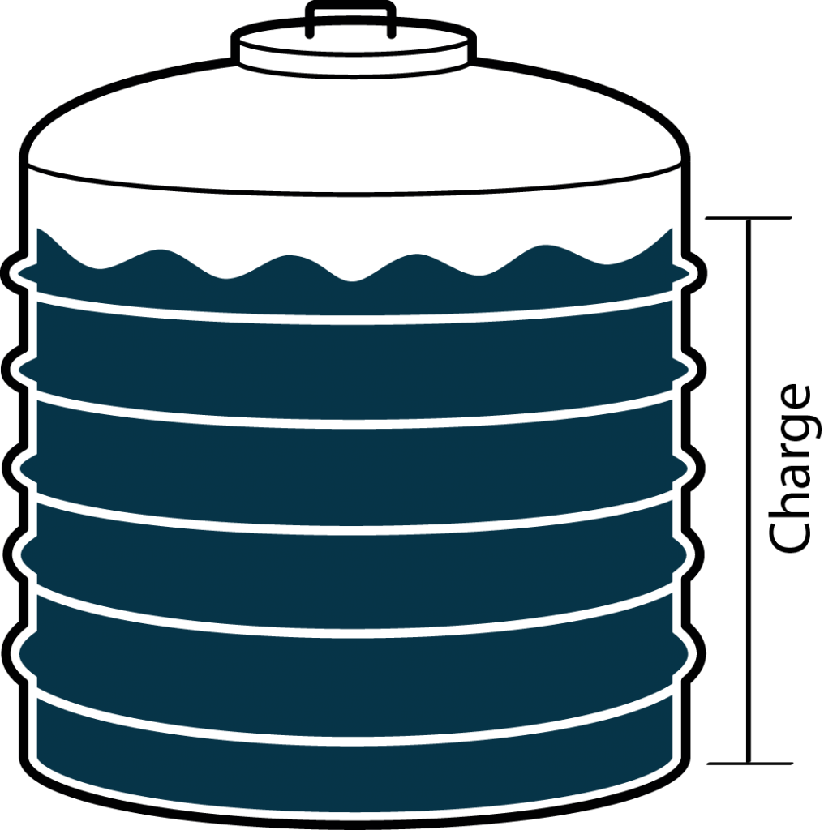
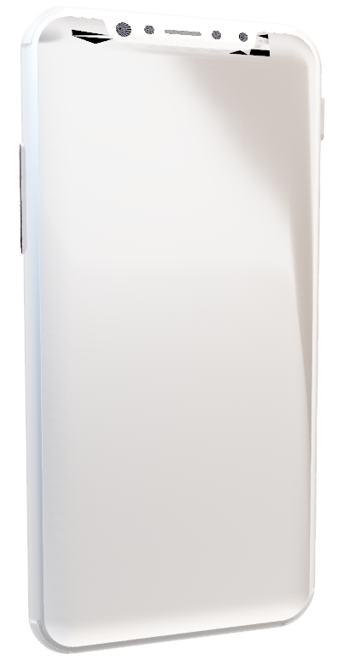
EXPECTED OUTCOME
Home
A portable device interfaced with water quality and leakage detection sensors that can be integrated into any reservoir system.
An AI-based mobile app for visualization and predictive analysis of consumption and prediction of water shortage.
90%
Stop Motor
4
8

Slide 11
REFERENCES
1. Wikipedia:
5. How2Electronics:
https://en.wikipedia.org/wiki/Ultraviolet_germicidal_irradiation#:~:text=Ultraviolet%20germicidal%20irradiation%20%28UVGI%29%20is%20a%20disinfection%20method,them%20unable%20to%20perform%20vital%20cellular%20functions.%20
https://how2electronics.com/ds18b20-temperature-sensors-to-microcontroller/
2. Amazon.in:
6. Data Reportal
https://www.amazon.in/Sintex-Ccws-Water-Double-Layered/dp/B077MJM617/ref=sr_1_7?crid=WWTQPIM17ZKG&keywords=water+tank&qid=1666242479&qu=eyJxc2MiOiI2LjA0IiwicXNhIjoiNS42OSIsInFzcCI6IjMuNTUifQ%3D%3D&sprefix=water+tank%2Caps%2C363&sr=8-7
https://datareportal.com/reports/digital-2022-global-overview-report
3. Circuit.Rocks:
https://circuit.rocks/ultrasonic-ranging-sensor-hc-sr04
4. Wikipedia:
https://en.m.wikipedia.org/wiki/Water_heating
4
9

